Slide 1
ESREL 2024 European Safety and Reliability Conference 23-27 June 2024
CRACOW, POLAND

Slide 2
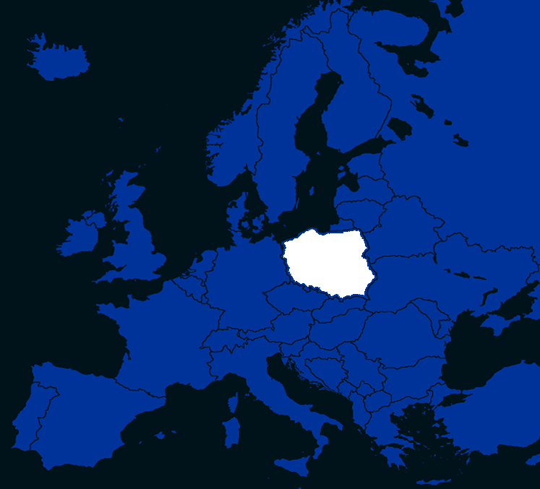
ESREL 2024 23-27 June 2024 CRACOW POLAND
CRACOW

Slide 3
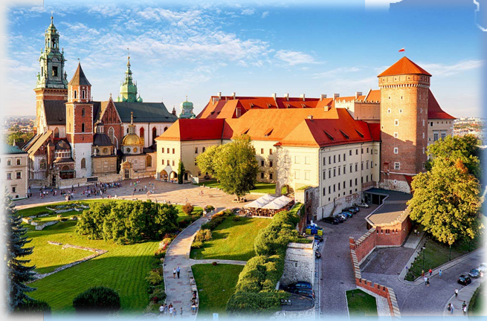
CRACOW EUROPEAN CAPITAL OF CULTURE
http://www.krakow-info.com/cracow.htm

Slide 4
CRACOW

Slide 5
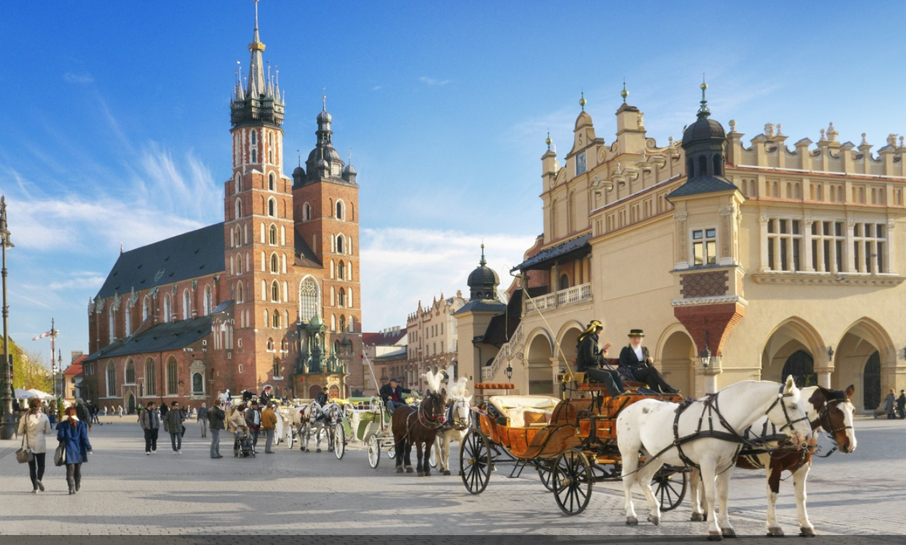
THE ST. MARY’S BASILICA, THE CLOTH HALL

Slide 6
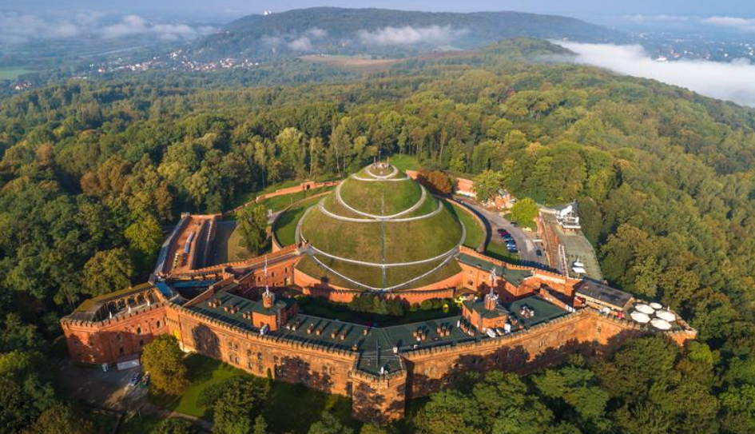
THE KOŚCIUSZKO MOUND

Slide 7
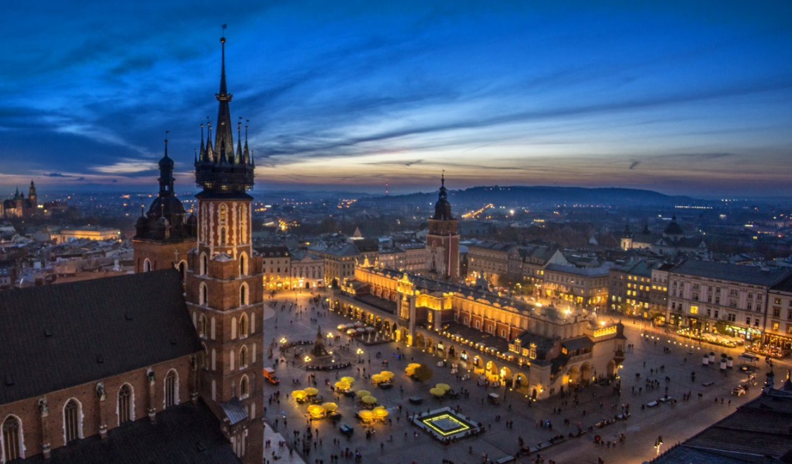
THE MARKET SQUARE

Slide 8
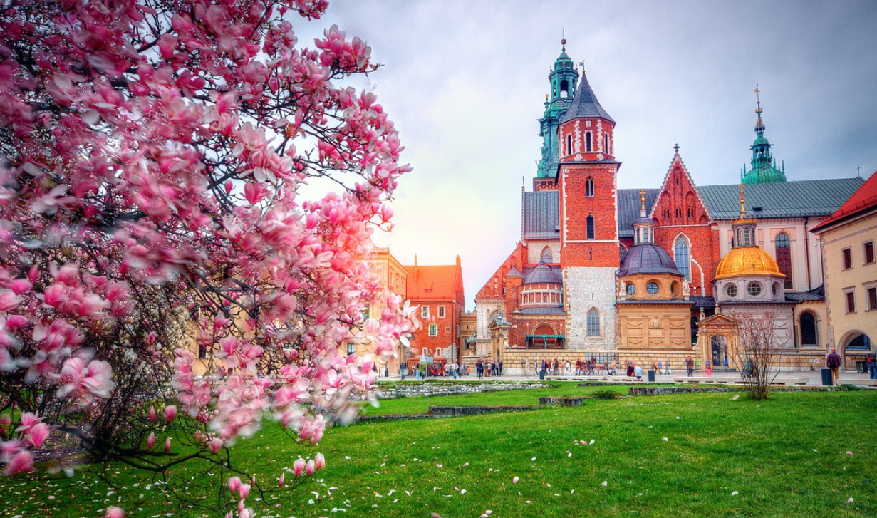
THE WAWEL ROYAL CASTLE

Slide 9
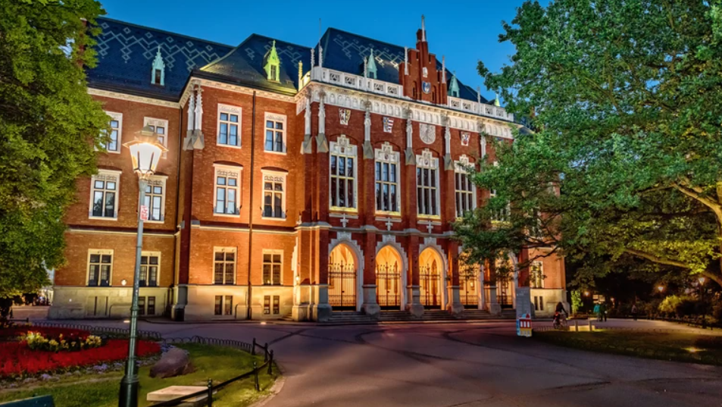
THE JAGIELLONIAN UNIVERSITY
ONE OF THE OLDEST UNIVERSITIES IN THE WORLD, TRADITIONALLY POLAND'S MOST REPUTABLE INSTITUTION OF HIGHER EDUCATION

Slide 10
NOTABLE LANDMARKS WORTH VISITING OUTSIDE THE CITY OF CRACOW

Slide 11
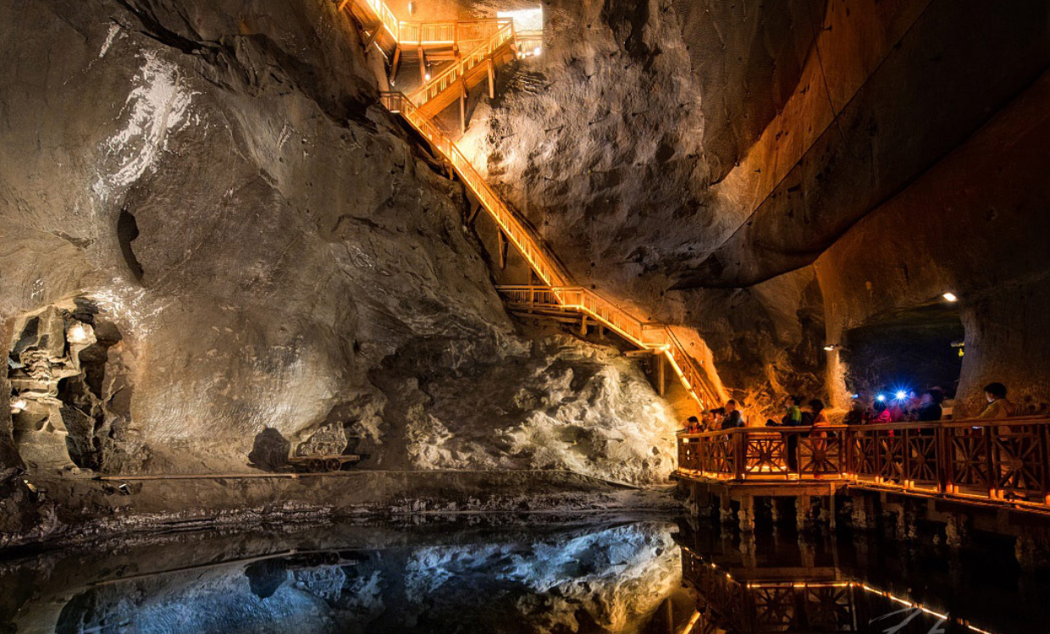
SALT MINE IN WIELICZKA

Slide 12
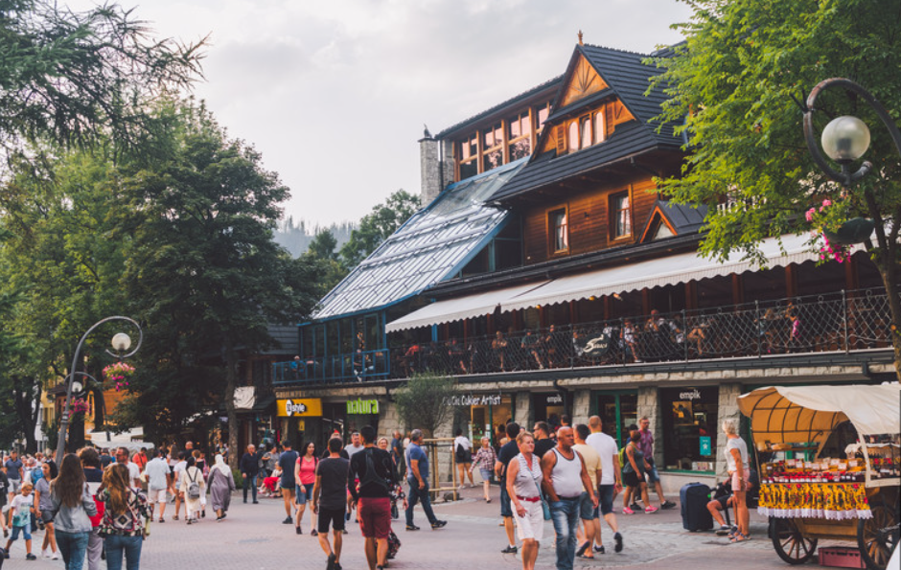
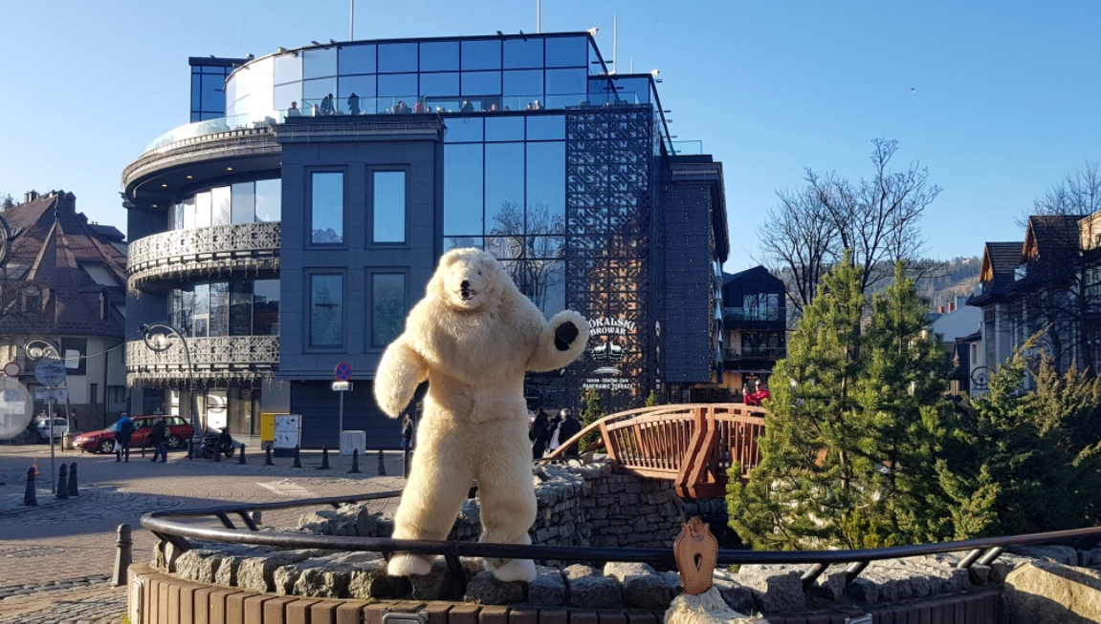
ZAKOPANE - KRUPÓWKI
TASTING FOOD, TASTING WINE.

Slide 13
THE TATRA MOUNTAINS

Slide 14
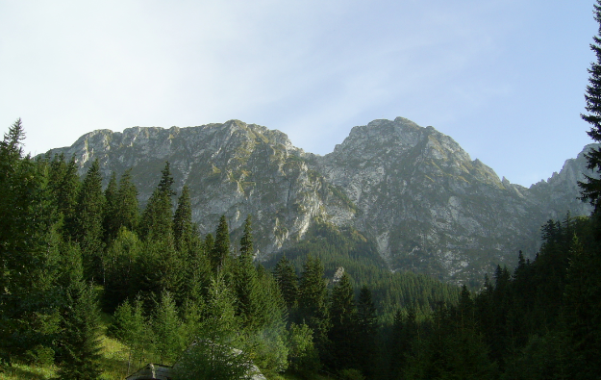
THE GIEWONT
IN POLISH FOLKLORE THE MOUNTAIN IS ASSOCIATED WITH A LEGEND ABOUT A SLEEPING KNIGHT WHO WILL AWAKE WHEN POLAND IS IN DANGER

Slide 15
ESREL 2024 CONFERENCE ITEMS: * KEYNOTE SPEECHES * SPECIAL SESSIONS * REGULAR SESSIONS * WORKSHOPS

Slide 16
ESREL 2024 SOCIAL EVENTS: * Reception, 23rd June * Visiting SALT MINE WIELICZKA, 24th June * Visiting WAWEL ROYAL CASTLE and Gala Dinner, 25th June * Farewell Party, 27th June * Coffee Breakes and Lunches, 24th-27th June

Slide 17
Post ESREL 2024 Workshop ITEMS: 28-30 June 2024 * TRAINING COURSES * RESEARCH PROJECT PROPOSALS

Slide 18
Post ESREL 2024 Workshop SOCIAL ITEMS: * Coffee Breakes and Lunches, 28th-30th June * Dinners, 28th and 30th June * Visiting KOŚCIUSZKO MOUND and Gala Dinner, 29th June

Slide 19
ESREL 2024 ORGANIZERS: * Europeran Safety and Reliability Association (ESRA) * Polish Safety and Reliability Association (PSRA)

Slide 20
ESREL 2024 CHAIRPERSONS: * Conference Chairmen Prof. Krzysztof Kołowrocki (PSRA) Prof. Magdalena Bogalecka (PSRA) * Conference Co-Chairmen Prof. Michael Beer (ESRA) Prof. Kazimierz Kosmowski (PSRA) Prof. Jacek Malinowski (PSRA) Prof. Edoardo Patelli (ESRA)

Slide 21
ESREL 2024 SCIENTIFIC COMMITTEE (212 members, still under completion): * Representatives of PSRA * Representatives of ESRA * Representatives of OTHER Safety and Reliability Associations and Organizations, Universities and Industries

Slide 22
ESREL 2024 ORGANIZING COMMITTEE: * Chairmen Dr. Ewa Dąbrowska (PSRA) MSc. Beata Magryta-Mut (PSRA) * Members Dr. Lucia Bautista (Extremadura University) MSc. Maciej Dąbrowski (PSRA) Dr. Alina Dereszewska (PSRA) Dr. Katarzyna Krasowska (PSRA) Others

Slide 23
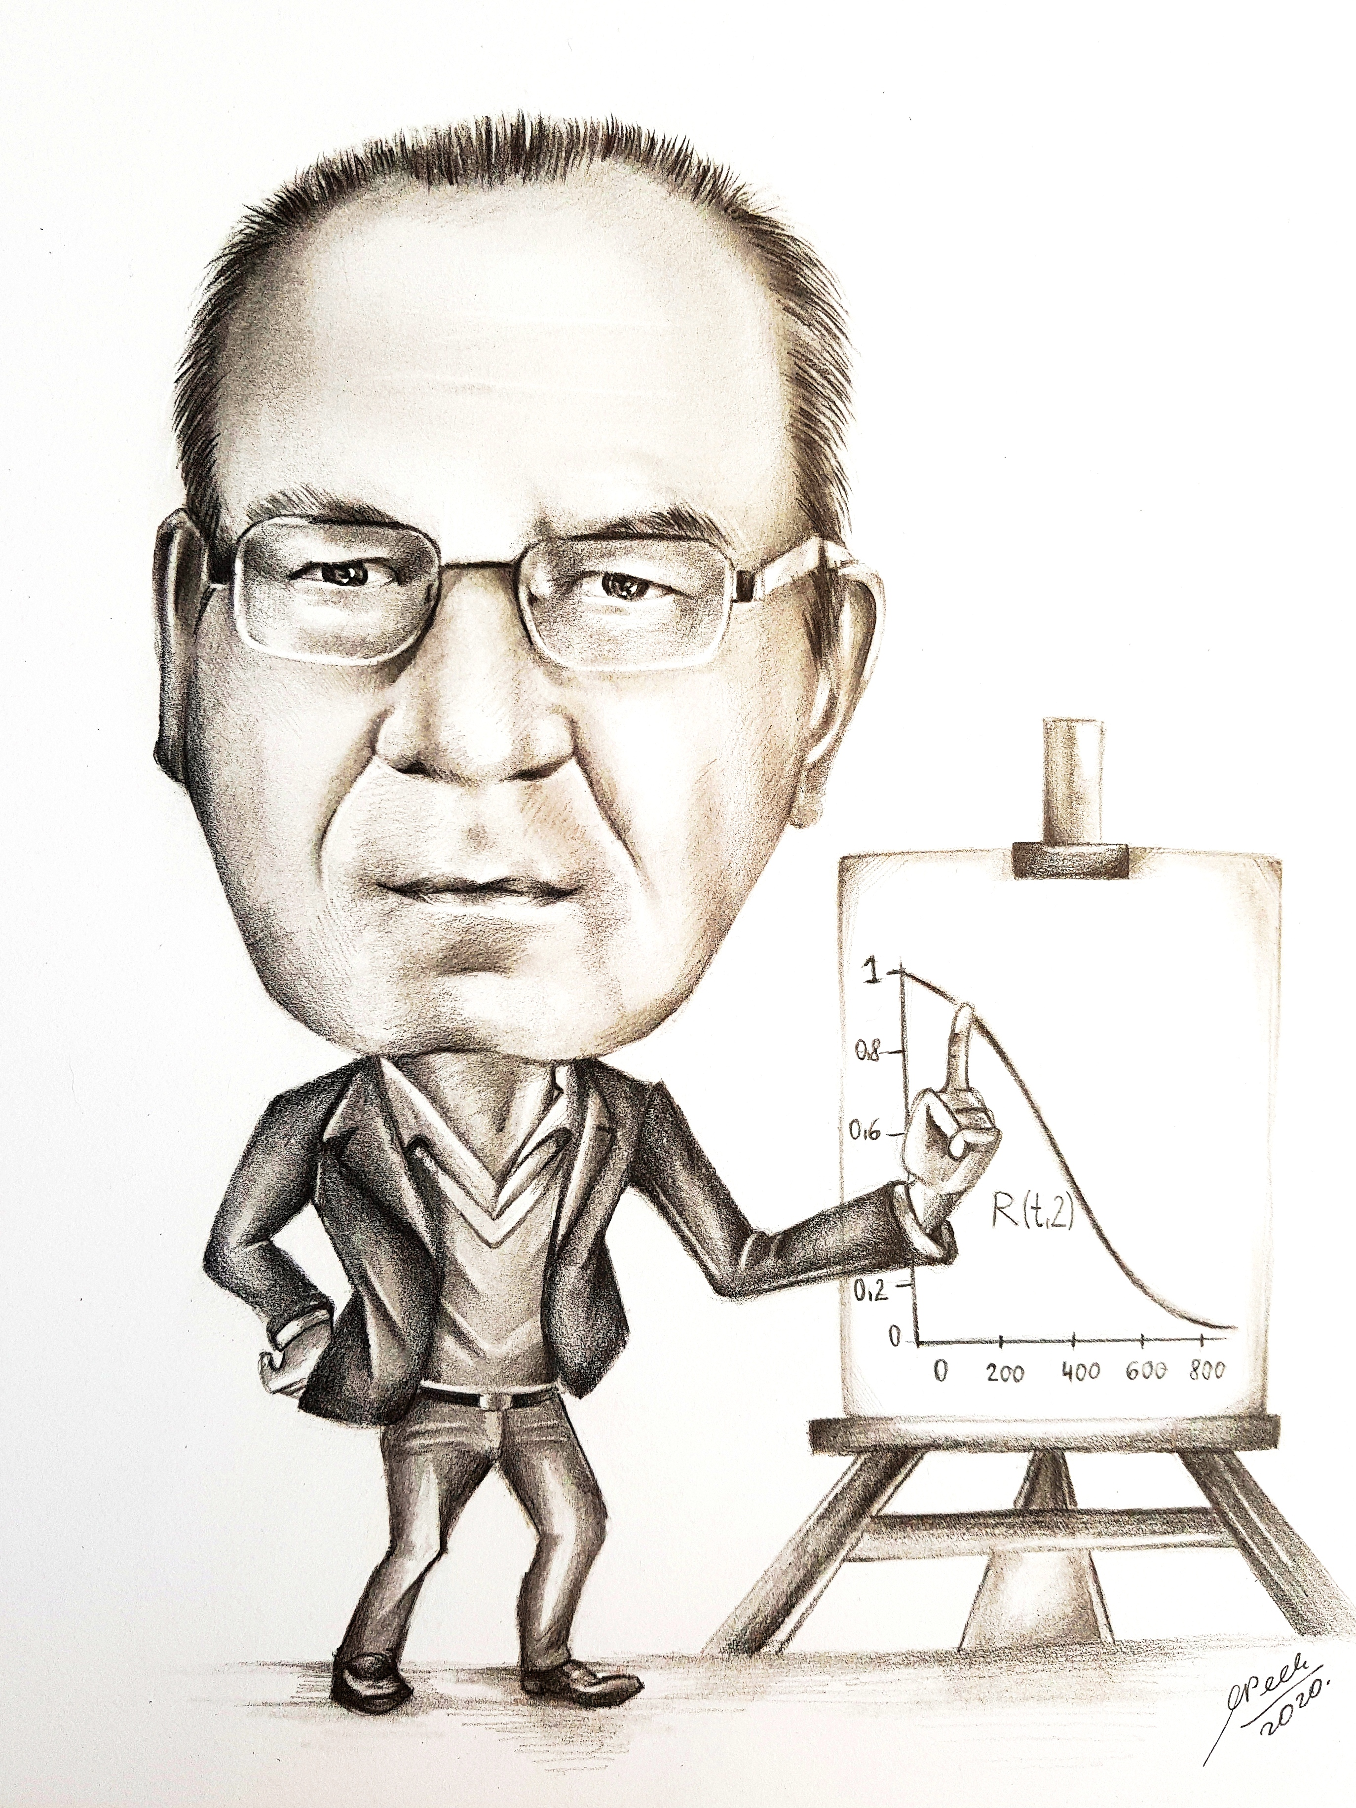
WELCOME TO ESREL 2024 and Post ESREL 2024 Workshop in CRACOW 23-30 June 2024 Krzysztof Kołowrocki

